Slide 1
FILE HANDLING

Slide 2
Problem
Consider the following scenario
-> You are asked to find the number of students who secured centum in mathematics in their examination. A total of 6 lakhs students appeared for the examinations and their results are available with us.
The processing is typically supposed to be automatic and running on a computer. As data are most helpful when presented systematically and in fact educational to highlight their practicality.

Slide 3
Pseudocode
OPEN file
REPEAT
READ each line of file
SET count = 0
PARSE the line
IF maths_mark == 100 THEN
COMPUTE count as count + 1
END IF
until end of file is reached
PRINT count

Slide 4

What
Next?
It is time to go find some Data to mess with!
Software
Input
and Output
Devices
Central
Processing
Unit
Files R with Us
Secondary
Memory
if x< 3: print
Main
Memory

Slide 5
Input / Output
Input is any information provided to the program
– Keyboard input
– Mouse input
– File input
– Sensor input (microphone, camera, photo cell, etc.)
Output is any information (or effect) that a program produces:
– sounds, lights, pictures, text, motion, etc.
– on a screen, in a file, on a disk or tape, etc.

Slide 6
Kinds of Input and Output
What kinds of Input and Output have we knew
– print (to the console)
– input (from the keyboard)
So far…
– Input: keyboard input only
– Output: graphical and text output transmitted to the computer screen
Any other means of I/O?

Slide 7
Necessity of Files
Small businesses accumulate various types of data, such as financial information related to revenues and expenses and data about employees, customers and vendors.
Traditional file organization describes storing data in paper files, within folders and filing cabinets.
Electronic file organization is a common alternative to paper filing; each system has its benefits and drawbacks.

Slide 8
What is a file?
A file is some information or data which stay in the computer storage devices. We already know about different kinds of file, like music files, video files, text files, etc.

Slide 9
Introduction to file handling
Files – Huge volume or Collection of data
Types – Binary, Raw, Text, etc.
Open any file before read/write.

Slide 10
Opening a File file object = open(file_name [, access_mode][, buffering])
Modes of opening a File:
r – Reading only
r+ - Both Read/Write
w – Writing only
w+ - Both Read/Write
A – Appending
a+ - Appending/Reading

Slide 11
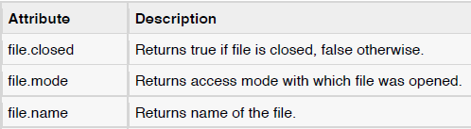
File Object Attributes

Slide 12
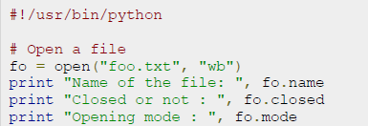
Example

Slide 13
Functions for file Handling
The read functions contains different methods:
read() #return one big string
readline() #return one line at a time
readlines() #returns a list of lines

Slide 14
File Handling functions contd..
This method writes a sequence of strings to the file.
write () #Used to write a fixed sequence of characters to a file
writelines() #writelines can write a list of strings.

Slide 15
Functions contd…
The append function is used to append to the file instead of overwriting it.
To append to an existing file, simply open the file in append mode ("a"):
When you’re done with a file, use close() to close it and free up any system resources taken up by the open file.

Slide 16
To open a text file, use:
fh = open("hello.txt", "r")
To read a text file, use:
fh = open("hello.txt","r")
print (fh.read() )
To read one line at a time, use:
fh = open("hello".txt", "r")
print (fh.readline() )
To read a list of lines use:
fh = open("hello.txt.", "r")
print (fh.readlines() )

Slide 17
To write to a file, use:
fh = open("hello.txt","w")
write("Hello World")
fh.close()
To write to a file, use:
fh = open("hello.txt", "w")
lines_of_text = ["a line of text", "another line of text", "a third line"]
fh.writelines(lines_of_text)
fh.close()
To append to file, use:
fh = open("Hello.txt", "a")
write("Hello World again")
fh.close ()

Slide 18
Playing Randomly in files
fileObject.tell() -> current position within a file
fileObject.seek(offset [,from]) -> Move to new file position.
Argument offset is a byte count.
Optional argument whence defaults to 0 (offset from start of file, offset should be >= 0); other values are 1 (move relative to current position, positive or negative), and 2 (move relative to end of file, usually negative, although many platforms allow seeking beyond the end of a file)

Slide 19
Example for random seeking
fobj = open('/tmp/tempfile', 'w')
fobj.write('0123456789abcdef')
fobj.close()
fobj = open('/tmp/tempfile')
fobj.tell() #tell us the offset position
0L
fobj.seek(5) # Goto 5th byte
fobj.tell()
5L
fobj.read(1) #Read 1 byte
'5'
fobj.seek(-3, 2) # goto 3rd byte from the end
fobj.read() #Read till the end of the file
'def'

Slide 20
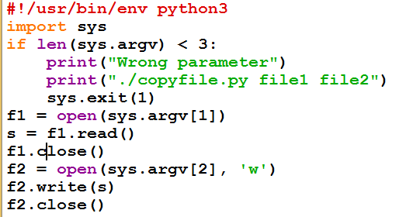

Slide 21
Tips and Tricks makes it Easier…
Number of characters in a file is same as the length of its contents.
def charcount(filename):
return len(open(filename).read())
Number of words in a file can be found by splitting the contents of the file.
def wordcount(filename):
return len(open(filename).read().split())
Number of lines in a file can be found from readlines method.
def linecount(filename):
return len(open(filename).readlines())

